Slide 1
AUTOMATIC WATER DISPENSER
PROJECT PRESENTED BY GROUP 18

Slide 2
WHAT IS AN AUTOMATIC WATER DISPENSER?
An automatic water dispenser is a device that automatically dispenses water without the need for manual intervention. It typically consists of a water reservoir, a pump, and a mechanism that releases the water when triggered. It can be programmed to dispense water at regular intervals or on demand, making them a convenient and efficient way to ensure that water is always available.

Slide 3
HOW IT WORKS
Most of the components were from an Arduino UNO kit. We used an HCSR04 Ultrasonic Sensor to check if any object such that the glass is placed before the dispenser. A relay and pump was used to control the flow of water, which when energized the water will flow out through a water pump.
So we wrote an Arduino code that always checks if an object is placed 5cm or closer to the tap, if yes then the relay switches the pump on and water is drawn from the bottle through the tubes, if no, the relay stays or switches off so no water flows.

Slide 4
COMPONENTS
ARDUINO UNO
HCSRO4- ULTRASONIC SENSOR
BREADBOARD
CONNECTING WIRES
WATER PUMP
RELAY
WATER TUBE

Slide 5
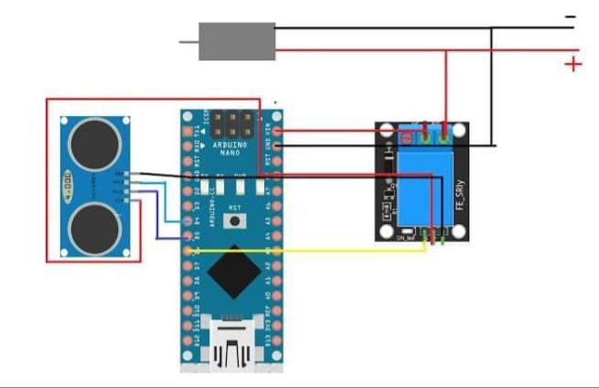
CIRCUIT

Slide 6
System flaws
Water still flows through the tube a few seconds after the cup is removed

Slide 7
references
Below is the Youtube link for the project we replicated.
The code and detailed description of the process can be found here.
https://youtu.be/uJ9r2lP-ARA

Slide 8
GROUP MEMBERS
HONU Seraphine Elorm
ANOKYE James Yaw
YAKUBU Umar Zaidu BENTUM
Edward Kwamena
YARTEY Don-Julian Yooku
EGBEM Emmanuel Sena
ABDUL-RAHMAN Muqtadir
AMOAKO William Kumuyi Anin
ESSIEN Elizabeth
ABAKAH Alexander Abeiku
KUMI Ernest
NYAME Stephen
ADU-GYAMFI Kwadwo
MOHAMMED Ibn Salmaan
KPARIB Ebenezer Yen

Slide 9
THANK YOU

